Slide 1
PROJECT MANAGEMENT
CT050-3-3
Version: NOV 2019
LECTURE 01
Introduction and Overview

Slide 2
Lecturer Information
Name:
Email:
Telephone Extension:

Slide 3
Pre-requisites for this Course
None

Slide 4
Aims of this Course
The module takes a structured approach to Project Management (PM) that refers to several PM methods that may be found in industry while following a well-tried set of steps that make a complex subject easier to learn.
The general aim of the module is to give a good understanding of the phases of managing typical IT project by integrating the technical and human factors into a realistic approach.

Slide 5
Course Learning Outcomes (CLO)
Explain the fundamentals of IT project management processes, lifecycle a typical IT project into manageable components (C5, PLO2)
Adhere a project management plan using the aims and objectives, deliverables, scope and appropriate standards through tools and techniques within processes of a typical IT project (A4, PLO8)
Practise project management governance to solve complexity in project using PMBOK standards (A5, PLO9)

Slide 6
Mapping of CLOs with MOEs Domain
Mapping of the Course Learning Outcomes to the Programme Learning Outcomes, Teaching Methods and Assessment :
Course Learning Outcomes (CLO) | Programme Learning Outcomes (PLO) |  |  |  |  |  |  |  |  |  |  | Teaching Methods | Assessment
 | PLO1 | PLO2 | PLO3 | PLO4 | PLO5 | PLO6 | PLO7 | PLO8 | PLO9 | PL10 | PL11
CLO 1 |  | ü |  |  |  |  |  |  |  |  |  | Lecture | Exam
CLO 2 |  |  |  |  |  |  |  | ü |  |  |  | Tutorial/ Case Study | Group Assignment
CLO 3 |  |  |  |  |  |  |  |  | ü |  |  | Tutorial/ Case Study | Individual Assignment
PLO2 – Cognitive Skills
PLO8 – Leadership, Autonomy and Responsibility Skills
PLO9 – Personal Skills

Slide 7
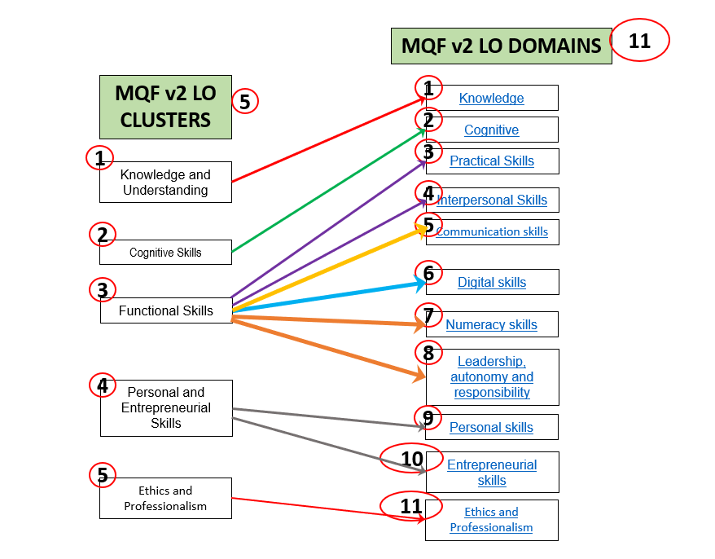
MQF Clusters and Domains

Slide 8
Teaching Strategies
Lecture
Tutorial
Case Study
Group Discussion
** Blended / Flipped Learning using Microsoft Teams platform

Slide 9
Assessment Methods
Group Assignment - 1000 words (20%)
Submission @ Week 6
Individual Assignment - 1000 words (20%)
Submission @ Week 12
Exam – 2 hours (60%)
**refer to SAIS for details

Slide 10
Student Learning Time (SLT)
Course Credit Value: 3
Total Learning Hours:
Lecture: 28 hours per semester
Tutorial: 21 hours per semester
Independent Learning Time: 71 hours

Slide 11
Methods of Delivery
Hence,
We are now moving from the traditional topic based teaching to outcome-based education

Slide 12
Outcomes Based Education (OBE)
OBE is education based on producing particular educational outcomes that:
Focus on what students can actually do after they are taught
Expect all learners / students to successfully achieve particular (sometimes minimum) level of knowledge and abilities.

Slide 13
So…What is OBE?
It’s
NOT
What WE want to teach,
It’s
What YOU should learn

Slide 14
Course Content Outline
Intro Project Program Portfolio Management
Intro Aligning Projects with Business Strategy
Initiating Projects
Planning Projects (Integration & Scope)
Planning Projects (Time & Cost)
Planning Projects (Quality, Resources & Communication)
Planning Projects (Stakeholder, Risk & Procurement)
Executing Projects
Monitoring & Controlling Projects
Closing Projects

Slide 15
What is Expected of You
You should abide by all the rules & regulations of APU
Proper attire
No speaking in languages other than English
Attendance is compulsory and valid medical certificates must support any absence from class
Three cases of lateness will be equal to one absence
All handphones should be turned off during lectures

Slide 16
What Support is Available for You
Consultation hours
Resources
Reference material
Internet resources

Slide 17
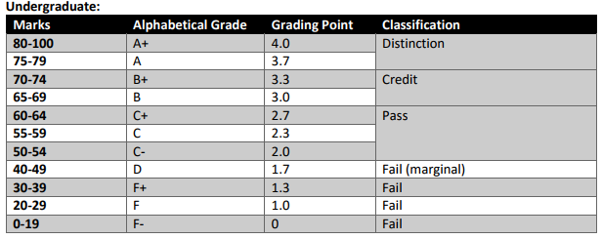
Achievement Requirements

Slide 18
Questions & answers

